Slide 1
Software Engineering :
2 : Software Processes
Professor Imed Bouchrika National School of Artificial Intelligence imed.bouchrika@ensia.edu.dz

Slide 2
Outline :
Software Process and Activities
Software Process Models
Traditional Methodologies
Agile Methodologies
XP, Scrum, DevOps
Choosing a Process Model

Slide 3
Software Process and Activities
To develop a Software for the “Hello World”
Requirement Analysis : Understand the problem
Design : Perform some design and planning
Implementation : Code and Develop the Software
Testing : Validate, Verify and Test the software
Integration : Release, Install, Run, Integrate or Deploy the software for the client
Maintenance : Maintenance, Evolution and Support

Slide 4
Software Process and Activities
Ideal Process :
Design and Planning
Implementation
Requirement Analysis
Maintenance
Testing
Integration

Slide 5
Software Process and Activities
Process in Reality :
Design and Planning
Implementation
Requirement Analysis
Maintenance
Testing
Integration

Slide 6
Software Process and Activities
Process :
is a collection of activities, actions, and tasks that are performed during the development life cycle of the software product including the maintenance phase.
The process is composed of activities which
Can be decomposed into actions or deliverables which
are composed of tasks

Slide 7
Software Process and Activities
Process Activities :
Generic Activities in a Software Engineering Process:
Requirements Specification
Design and Planning
Coding/Implementation/Construction
Testing
Integration
Maintenance

Slide 8
Software Process and Activities
Process Activities : The following information needs to be defined :
Deliverable : The outcome of the activity, for example:
Architectural Design
Specification Documentation
Role : Reflects the responsibilities of the people involved in the activity
Condition ( Pre- or Post- ) : Statements or conditions before or after the activity. For example, the design Activity :
Pre-condition : Specification Requirements Activity must be completed
Post-condition : Architectural Designs must be reviewed by an Expert.

Slide 9
Software Process and Activities
Umbrella Activities :
Software engineering process framework activities are complemented by a number of umbrella activities including :
Software Project Management and Control
Technical Review and Inspection
Risk Management
Software Quality Assurance
Measurement and Metrics
…

Slide 10
Software Process and Activities
Activity Task :
It is a work unit with a specific purpose related to the larger goal defined within an activity or an action.
Tasks can be of different types, Examples of Tasks :
Implementation of new Functionality
Fix Bug of the system A
Buy some equipment
Negotiate a deal with a supplier
Send Invoices to Customer
Collect data from end-users
Hire a Translator
Setup Git Repository …

Slide 11
Software Process and Activities
Activity Task :
Task is usually assigned to a single employee at a time
Task can be reassigned to another employee ( even at different department)
The task can be moved from different activity phases depending on the organization of the company and the activity,
Example of possible activity phases :
To do → In Progress → Done
Idea/Backlog →To do → In progress → To Review →Completed → Delivered
Backlog →In Plan → Started →Completed → To Deliver → To Accept →Closed → Trash

Slide 12
Software Process and Activities
Activity Task : Phases
Backlog → New Ideas , New Features, Possible Bugs, any other tasks to do.
In Plan → Features/Tasks/Bugs that have been confirmed to be taken into consideration
Started → Tasks that employees have started to work on them.
Completed → Tasks where the employees claimed to have completed them provided that completion is reviewed by their manager.
To Deliver → The task/feature/bug fix is pending integration/release into the production system
To Accept → The task/feature/bug is pending acceptance by the client or task owner
Closed → The task is fully completed, delivered and accepted.
Trash → This task/feature/functionality is ignored

Slide 13
Software Process and Activities
Activity Task : Phases
Backlog → New Ideas , New Features, Possible Bugs, any other tasks to do.
In Plan → Features/Tasks/Bugs that have been confirmed to be taken into consideration
Started → Tasks that employees have started to work on them.
Completed → Tasks where the employees claimed to have completed them provided that completion is reviewed by their manager.
To Deliver → The task/feature/bug fix is pending integration/release into the production system
To Accept → The task/feature/bug is pending acceptance by the client or task owner
Closed → The task is fully completed, delivered and accepted.
Trash → This task/feature/functionality is ignored
You can have one generic workflow of phases for all activities Or Each activity can have its specific flow of phases

Slide 14
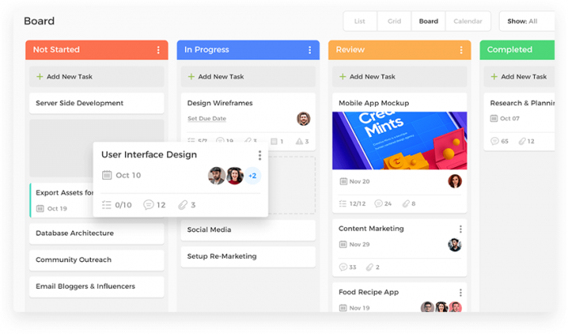
Software Process and Activities
Activity Task :
Kanban/Board View: Visual way to provide an insight about the tasks and at which stage of the workflow are at.

Slide 15
Software Process and Activities
Activity Task :
Policies for completing a Task.
A task is should never be marked completed by the staff executing the task
When the executor feels that the task is completed
They assign the task back to their manager or (N+1) informing them that the task is completed.
The manager would later decide either to mark it completed or re-assign the task to another employee to verify and check.

Slide 16
Software Process and Activities
Activity Task :
The complexity of tasks can differ and if necessary:
Sub-tasks can be created inside a given task to :
Distribute the load among other employees
Have better insight on the progress of the task

Slide 17
Software Process and Activities
Activity Task :
Due date : the project manager or the executor of the task must set a due date indicating when the task should be completed.
Task Duration : For better estimation of the project cost, the time spent on a task must be recorded on the employee timesheet.
Task Dependencies : There are tasks which rely on other tasks. Bad communication or improper prioritization can lead to the stagnation of the project.

Slide 18
Software Process Models
What’s a Process Model :
is a description of what activities/tasks need to be performed in what sequence under what conditions by whom to achieve the desired results
is an abstract representation of how a process is conducted in terms of structuring and ordering the tasks to develop the software product
The model describe the process flow

Slide 19
Software Process Models
What’s a Process Model :
It can be linear workflow
Activity 1
Activity 2
Activity 3
Activity 4

Slide 20
Software Process Models
What’s a Process Model :
Or iterative/cyclic workflow
Activity 1
Activity 2
Activity 4
Activity 3

Slide 21
Software Process Models
What’s a Process Model :
Or even parallel workflows
Activity 1
Activity 2
Activity 3
Activity 4
Activity 1’
Activity 2’
Activity 3’
Activity 4’
Combine
Activity 1’’
Activity 2’’
Activity 3’’
Activity 4’’

Slide 22
Software Process Models
Why a software process model :
is to provide guidance for systematically coordinating and controlling the tasks that must be performed in order to achieve the end product and the project objective ( = Be organized )
What if the development is done by one person ? do we still need a adopt a process model ?

Slide 23
Software Process Models
Why a software process model :
is to provide guidance for systematically coordinating and controlling the tasks that must be performed in order to achieve the end product and the project objective
What if the development is done by one person ? do we still need a adopt a process model ?
There is a disagreement about the need to use a specific process model for a one-man team but : It is always recommended to adopt a process model for keeping yourself organized and keep the growing list of tasks/features/bugs under control.

Slide 24
Software Process Models
Why a software process model :
Software product needs to be of high quality
The quality and productivity achieved in a software project depends on the process framework used for executing the project

Slide 25
Software Process Models
Types of Process Models
Plan-Driven Processes :
are processes where all of the process activities are planned in advance and progress is measured against this plan

Slide 26
Software Process Models
Types of Process Models
Agile Processes :
Planning is incremental and it is easier to change the process to reflect changing customer requirements.

Slide 27
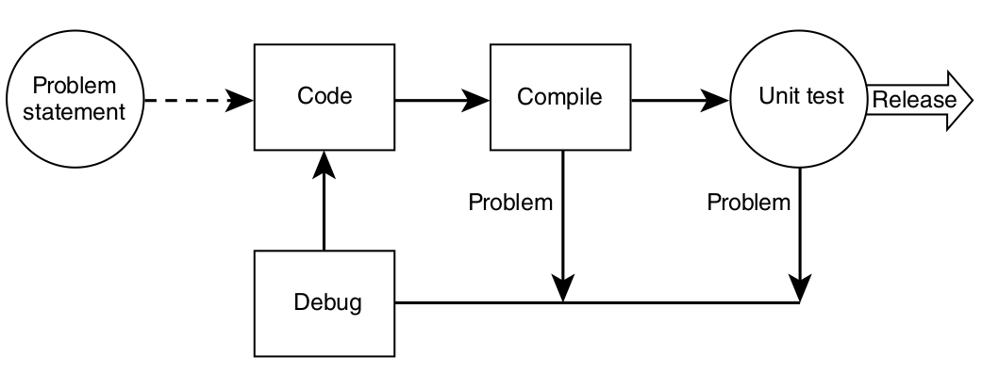
Software Process Models: Simplest Process Model
Code-and-Fix Model :
No specification or design are made, developers would aim to focus heavily on the coding aspect
Anytime, there is an error or a functionality to be implemented, the developers will intervene the fix the error or do further coding.
It is rare that the documentation are produced

Slide 28
Software Process Models: Simplest Process Model
Code-and-Fix Model :
No specification or design are made, developers would aim to focus heavily on the coding aspect
Anytime, there is an error or a functionality to be implemented, the developers will intervene the fix the error or do further coding.
It is rare that the documentation are produced
Who does the testing ?

Slide 29
Software Process Models: Simplest Process Model
Code-and-Fix Model :
No specification or design are made, developers would aim to focus heavily on the coding aspect
Anytime, there is an error or a functionality to be implemented, the developers will intervene the fix the error or do further coding.
It is rare that the documentation are produced
The developers themselves do the testing because :
There is no documentation or specification to tell the testers about the software, its functionalities, problem to be solved…

Slide 30
Software Process Models: Simplest Process Model
Code-and-Fix Model :
As
software products are becoming more complex
Increasing number of tasks with changing requirements
More people are involved
This model would not be a fit to most large software projects
Software is not maintainable
Higher costs
Quality is questionable

Slide 31
Software Process Models: Traditional Methodologies
Requirement Analysis
Waterfall Model :
Design and Planning
Implementation
Testing
Integration
Maintenance

Slide 32
Software Process Models: Traditional Methodologies
Waterfall Model :
Move from one phase to the next only when its preceding phase is completed and perfected
The output from each stage is fed into the next stage in sequence.
US department of defence projects attempted to entrench this model by requiring their contractors to produce the waterfall deliverables and then to formally accept them to a certain schedule (US military standard DoD-2167)

Slide 33
Software Process Models: Traditional Methodologies
Waterfall Model :
Strength :
Works for well-understood problems
Forces the software team to complete requirements before design, design before code…
It is easy to manage due to the rigidity of the model – each phase has specific deliverables and a review process.
It can protect the company from the risk of diving into never ending requirements and changes.

Slide 34
Software Process Models: Traditional Methodologies
Waterfall Model :
Weakness :
Does not allow for changing requirements
Does not work for novel or poorly understood problems
Lack of user involvement once specification is written
Unrealistic separation of specification from design
There are debates on the possibility to get back from design to specification
Doesn’t easily accommodate prototyping, reuse ..
No working software is produced until late during the life cycle.

Slide 35
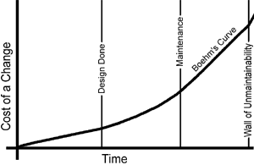
Software Process Models: Traditional Methodologies
Waterfall Model :
Barry Boehm’ Cost of Change (1981) :
Software Engineering Economics
Data from waterfall-­based projects in 1970s at IBM

Slide 36
Software Process Models: Traditional Methodologies
Waterfall Model :
When to use it :
Embedded systems : Because of the inflexibility of hardware, The software’s functionality must be therefore specified clearly to accommodate the hardware without the unpredictability to change.
Critical systems where there is a need for extensive safety and security analysis of the software specification and design. Safety-related problems in the specification and design are usually very expensive to correct at the implementation stage.
Large software systems that are part of broader engineering systems developed by several partner companies.

Slide 37
Software Process Models: Traditional Methodologies
Waterfall Model :
When not to use it :
The waterfall model is not the right process model in situations where :
Software requirements change quickly.
Informal communication among teams/members/customer
Iterative development and agile methods are better for these systems

Slide 38
Software Process Models: Traditional Methodologies
Waterfall Model :
Classical Waterfall :
No going back to a previous activities.
Iterative Waterfall Model :
You can go back to earlier Activities by providing Feedback Path
Requirement Analysis
Design and Planning
Implementation
Testing
Integration
Maintenance

Slide 39
Software Process Models: Traditional Methodologies
Incremental Process Model:
Requirement Analysis
Requirement Analysis for Part A
Design and Planning for A
Requirement Analysis for Part B
Design and Planning for B
Implementation of A
Requirement Analysis for Part C
Test Build A
Maintenance
Implementation of B
Design and Planning for C
Integration A
Test Build B
Implementation of C
Integration B
Full System
Test Build C
Integration C

Slide 40
Software Process Models: Traditional Methodologies
Incremental Process Model:
Requirements of the Full Software are first broken down into several modules/Subsystems/Set of Functionalities that can be incrementally constructed and delivered consecutively
Initially : The Development Team ensures the development of core features of the system as the first release.
Once the core features are fully developed, then new modules/functionalities are added in Successive versions.
Each incremental version is usually developed using an iterative waterfall model of development.

Slide 41
Software Process Models: Traditional Methodologies
Incremental Process Model:
Strength
Uses divide and conquer for a breakdown of tasks and complexity reduction.
Clients have a clear idea of the project with constant feedback from the client at each release
Incremental Resource Deployment.
Weakness
Because of its continuous iterations the cost increases.
Lack of an overall vision for the long term plan
Potential risk to break a production system

Slide 42
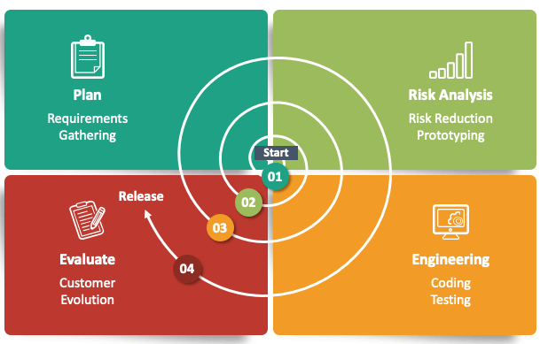
Software Process Models: Traditional Methodologies
Spiral Process Model:
Start by planning,..

Slide 43
Software Process Models: Traditional Methodologies
Spiral Process Model:
is a risk-driven model where the focus is on managing risk through multiple iterations of the software development process.
There are many iteration where each iteration of the spiral has four activities which represents a complete software development cycle, from requirements gathering and analysis to design, implementation, testing, and maintenance.

Slide 44
Software Process Models: Traditional Methodologies
Spiral Process Model:
The main activities/four quadrants within each spiral iteration are :
Planning : Requirements are gathered from the customers and the objectives are identified. Then alternative solutions possible for the phase are proposed in this quadrant. Previous evaluation feedback can be utilized for the planning.
Risk Analysis : Identify and resolve Risks based on analysing the proposed solutions. At the end of this activity, the Prototype is built for the best possible solution.
Engineering : The identified features are developed and verified through testing. At the end of the third quadrant, the next version of the software is released to the customer.
Evaluate : the Customers evaluate the released version of the software.

Slide 45
Software Process Models: Traditional Methodologies
Maintenance
Integration
Prototyping Process Model:
Build Prototype
Testing
Requirement Analysis
Quick Design
Prototype Evaluation
Implementation
Review and Update

Slide 46
Software Process Models: Traditional Methodologies
Prototyping Process Model:
Prototyping is the process to produce a replica of the software product with minimal efforts and quickly.
The prototype should exhibit the main functionality to be engineered. Though, it can be a non-functional system without any business logic
The aim is to quickly create or build a prototype to clarify the requirements.
The clients can therefore express clearly their needs by having something similar to the product they are expecting.

Slide 47
Software Process Models: Traditional Methodologies
Prototyping Process Model:
Prototyping is an iterative process requiring designing, building , feedback, refining.
Once the requirements are fully understood, the customer is happy with the prototype
The prototype is disregarded as it does not meet the quality standards
The full system is built and implemented based on the prototype

Slide 48
Software Process Models: Traditional Methodologies
Prototyping Process Model:
Prototyping Tools:
Mockups ( Pen and Papers, or even software tools)
Online tools:
Figma, Balsamiq, proto.io ,,,
Visual Tools (Widgets with Drag and Drop) for rapid application development.

Slide 49
Software Process Models: Traditional Methodologies
Prototyping Process Model:
Strength
Better way to get the requirements correctly
Weakness
Can be costy to build throwaway prototypes+ time consuming
Bad Perception/Appreciation about the effort/pricing of the final product:
Too fast to be build the prototype → to build the software product, must be quick too.

Slide 50
Software Process Models: Traditional Methodologies
Other Process Models for Software Engineering:
Rapid Application Development
V Model
…

Slide 51
Software Process Models: Traditional Methodologies
Major Drawbacks of Traditional Methodologies
Lengthy development times:
Inability to cope with changing requirements
Too much reliance on heroic developer effort
Waste/duplication of effort ( Example .. Much documentation is mandated, including documentation that may or may not be needed)

Slide 52
Software Process Models: Agile Methodologies
What’s Agile
Agile processes are a family of software development methodologies that produce software in short iterations and allow for greater changes in design.
Although there is no absolute definition about what constitutes an Agile method, there are several characteristics shared by most Agile methods
The philosophy behind agile methods is reflected in the agile manifesto ( http://agilemanifesto.org) issued by the leading developers of these methods

Slide 53
Software Process Models: Agile Methodologies
Agile Manifesto:
We are uncovering better ways of developing software by doing it and helping others do it. Through this work we have come to value:
Individuals and interactions over processes and tools
Working software over comprehensive documentation
Customer collaboration over contract negotiation
Responding to change over following a plan
That is, while there is value in the items on the right, we value the items on the left more

Slide 54
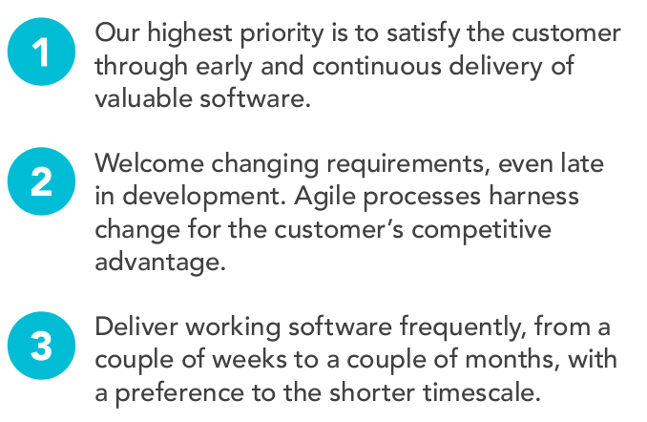
Software Process Models: Agile Methodologies
Agile Principles

Slide 55
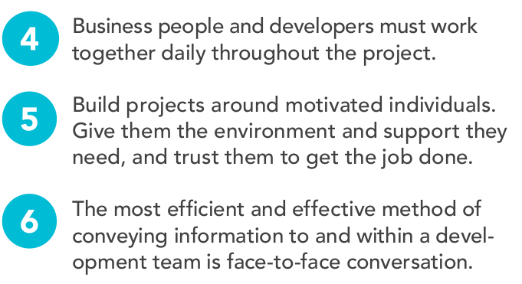
Software Process Models: Agile Methodologies
Agile Principles

Slide 56
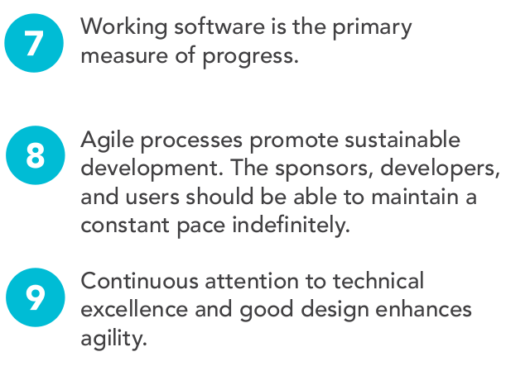
Software Process Models: Agile Methodologies
Agile Principles

Slide 57
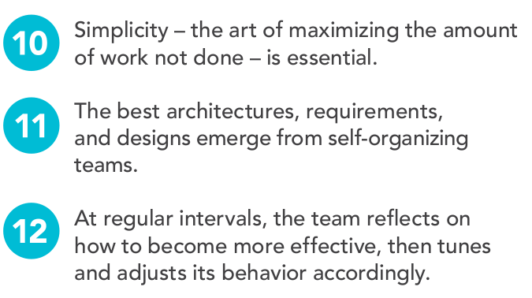
Software Process Models: Agile Methodologies
Agile Principles

Slide 58
Software Process Models: Agile Methodologies
Agile Principles Rephrased and Explained
01
Short releases and iterations :
Divide the work into small pieces.
Release the software to the customer as often as possible.
Every release/sprint should have a set newer functionalities/bug fixes based on their priorities

Slide 59
Software Process Models: Agile Methodologies
Agile Principles Rephrased and Explained
02
Incremental design:
Don’t try to complete the design up front because not enough is known early about the system.
Delay design decisions as much as possible, and improve the existing design when more knowledge is acquired.

Slide 60
Software Process Models: Agile Methodologies
Agile Principles Rephrased and Explained
03
User involvement :
Rather than trying to produce formal, complete, immutable standards at the beginning,
Ask the users involved with the project to provide constant feedback.
Customers should be closely involved throughout the development process.

Slide 61
Software Process Models: Agile Methodologies
Agile Principles Rephrased and Explained
04
Embrace change
Expect the system requirements to change, and so design the system to accommodate these changes.

Slide 62
Software Process Models: Agile Methodologies
Agile Principles Rephrased and Explained
05
People, not process :
The skills of the development team should be recognized and exploited.
Team members should be left to develop their own ways of working without prescriptive processes.

Slide 63
Software Process Models: Agile Methodologies
Agile Principles Rephrased and Explained
06
Maintain simplicity
Focus on simplicity in both the software being developed and in the development process including the communication activity
Actively work to eliminate complexity from the system.

Slide 64
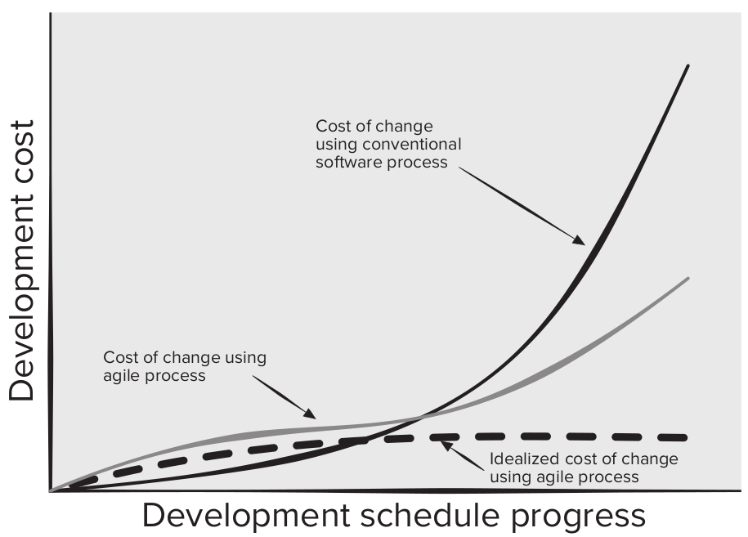
Software Process Models: Agile Methodologies
Agile Processes vs Traditional Processes when it comes to Handling Changes

Slide 65
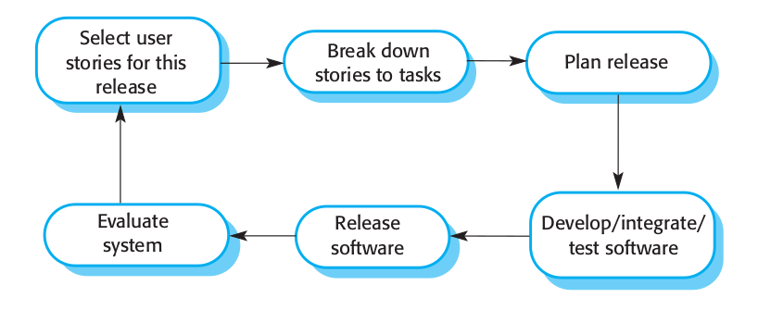
Software Process Models: Agile Methodologies
XP Process Model

Slide 66
Software Process Models: Agile Methodologies
XP Process Model
XP is an acronym for eXtreme Programming
The most widely used agile process
This approach uses user stories or scenarios for requirements, test-driven development, has direct customer involvement on the team (typically defining acceptance tests), uses pair programming, and provides for continuous code refactoring and integration.

Slide 67
Software Process Models: Agile Methodologies
XP Process Model
Why Pair Programming:
It supports the idea of collective ownership and responsibility for the system
It acts as an informal review process because each line of code is looked at by at least two people
It encourages refactoring to improve the software structure, readability of source code and even maintainability

Slide 68
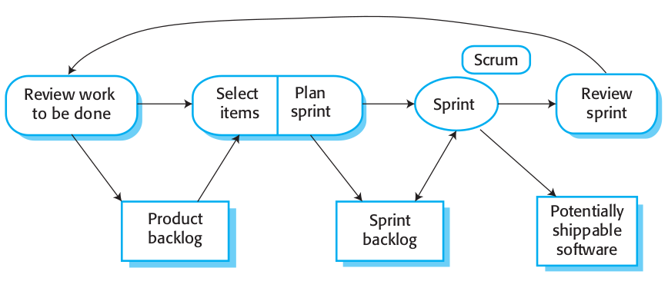
Software Process Models: Agile Methodologies
Scrum Process Model

Slide 69
Software Process Models: Agile Methodologies
Scrum Process Model
Another popular Agile methodology!
It provides a framework for agile project organization, and it does not mandate the use of specific development practices or process model
The scrum master manages the activities within the project increment; each increment is called a sprint and lasts no more than 30 days.
A product backlog item (PBI) list is developed from which tasks are identified, defined, prioritized, and estimated.
Daily scrum meetings ensure work is managed to plan.

Slide 70
Software Process Models: Agile Methodologies
Scrum Process Model
Why Scrum :
The product is broken down into a set of manageable and understandable chunks/deliverables
Unstable requirements do not hold up progress
Customers see on-time delivery of increments and gain feedback on how the product works
The whole team has visibility of everything, and consequently team communication and morale are improved
Trust between customers and developers is established

Slide 71
Software Process Models: Agile Methodologies
DevOps
was created by Patrick DeBois to combine Development and Operations
The DevOps involves several stages that loop continuously until the desired product exists
Continoius development, continuous testing, continuous integration, continuous deployment, continuous monitoring

Slide 72
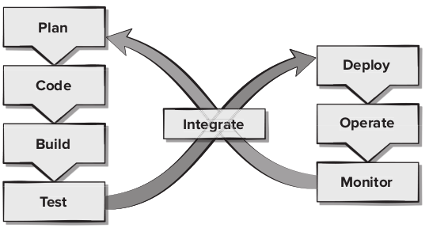
Software Process Models: Agile Methodologies
DevOps

Slide 73
Software Process Models: Agile Methodologies
Major Problems for Agile Methodologies:
The informality of agile development is incompatible with the legal approach to contract definition that is commonly used in companies
Agile methods are most appropriate for new software development rather than for software maintenance. Yet the majority of software costs in large companies come from maintaining their existing software systems.

Slide 74
Software Process Models: Agile Methodologies
Major Problems for Agile Methodologies:
The informality of agile development is incompatible with the legal approach to contract definition that is commonly used in companies
Agile methods are most appropriate for new software development rather than for software maintenance. Yet the majority of software costs in large companies come from maintaining their existing software systems.
There is no clear consensus on the suitability
of agile methods for software maintenance

Slide 75
Choosing a Process Model
Remember :
There is no best software process or set of software processes.
No software process works well for every project.
Software processes must be selected, adapted, re-adjusted and applied as appropriate for each project, for each team and for each organizational context.

Slide 76
Choosing a Process Model
It is a war over which is which :
There is considerable debate (sometimes strident) about the benefits and applicability of agile software development as opposed to more conventional software engineering processes.
Produce flawless documentation than a working system that meets business needs.
Be a glorified hacker who is going to be surprised when they try to scale up their software into enterprise-wide software.

Slide 77
Choosing a Process Model
It is a war over which is which :
Keep in mind that working software is important, but don’t forget that it must also exhibit a variety of quality attributes including reliability, usability, scalability and maintainability.
How do you build software that meets customers’ needs today and exhibits the quality characteristics that will enable it to be extended and scaled to meet customers’ needs over the long term ?

